Slide 1

IoT Revolution: Shaping the Future of Connectivity
Dr. Bhale Pradeepkumar, Assistant Professor Department of Computer Science & Engineering, IIITDM Kancheepuram pradeepkumar@iiitdm.ac.in
Notes:
Gud evening one and all, today I am presenting my annual progress seminar, under the supervision of Prof Sukumar Nandi and dr. Santosh Biswas

Slide 2

Presentation Outline
Introduction to IoT
IoT Architecture and Components
IoT Applications
IoT Data Management
IoT Connectivity
Security in IoT
IoT Development
Emerging Trends and Advanced Topics
Case Studies
IoT Future and Conclusion

Slide 3

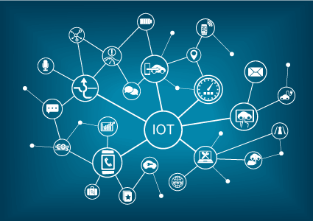
Introduction
What is IoT ?
Internet connects all people
Internet connects all things
“Internet of People”
“Internet of Things”

Slide 4
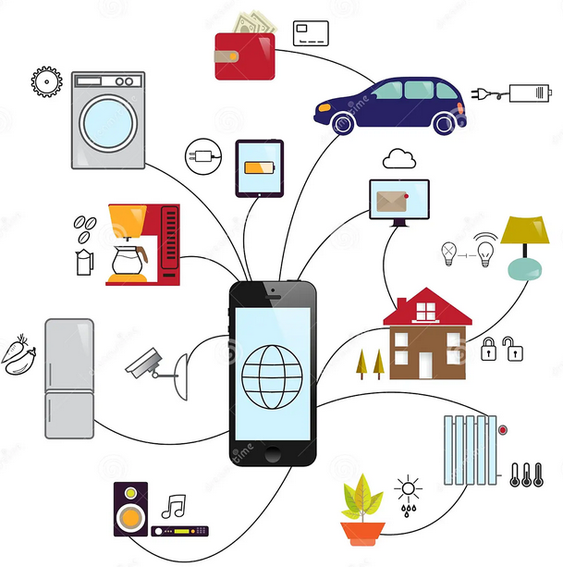
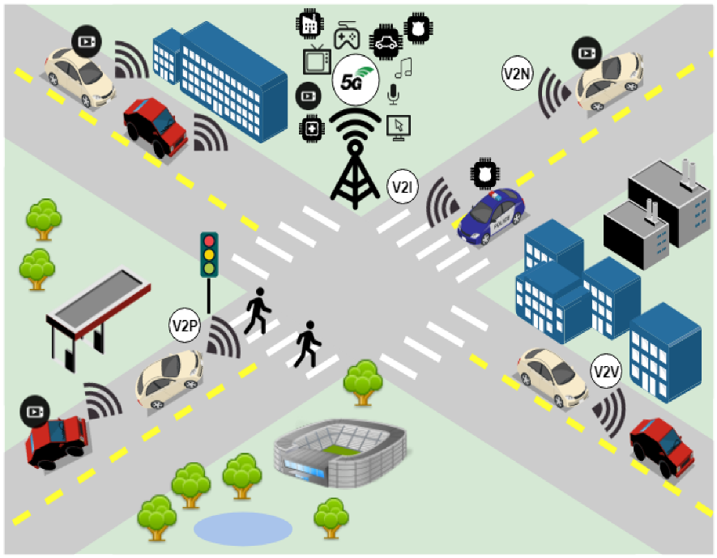
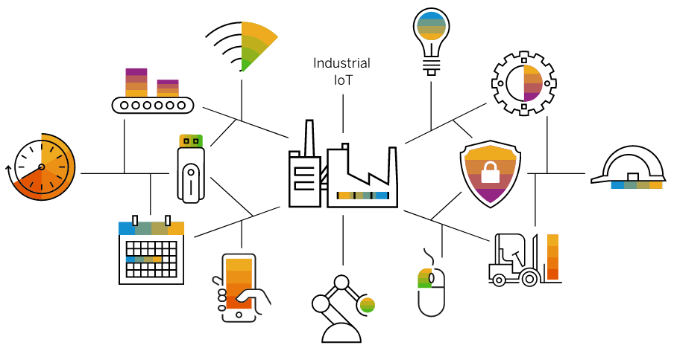
Introduction
Interconnection of Things or Objects or Machines, e.g., sensors, actuators, mobile phones, electronic devices, home appliances, any existing items and interact with each other via Internet.
1. Smart home
2. Smart city
3. Smart Industry

Slide 5
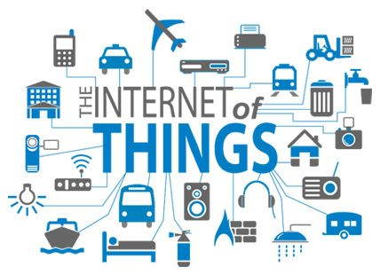
Introduction
IoT definition:
Internet of Things (IoT) is a network of sensors, actuators, embedded and wearable devices that can connect to the Internet.
Various researchers have described IoT in multitude forms:
IoT refers to the stringent connectedness between digital and physical world (Atzori et al., 2010; Sterling, 2005; Internet Reports, 2005).

Slide 6
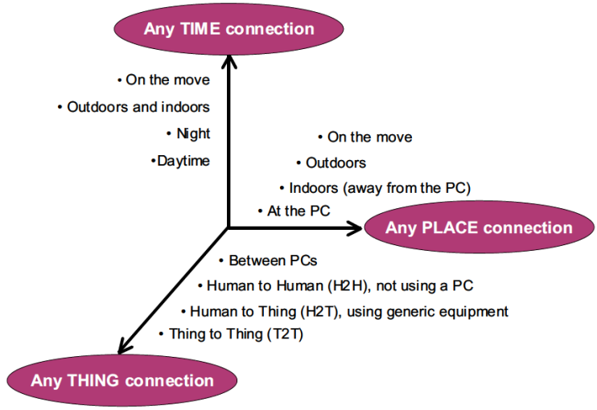
Introduction
IoT definition:
From any time ,any place connectivity for anyone, we will now have connectivity for anything!

Slide 7
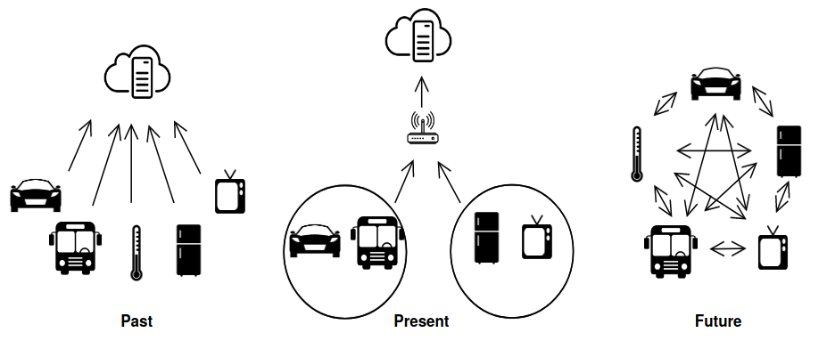
Introduction
Internet of Things (IoT) is a network of sensors, actuators, embedded and wearable devices that can connect to the Internet.
Fig. 1: Evolution of IoT [1]

Slide 8
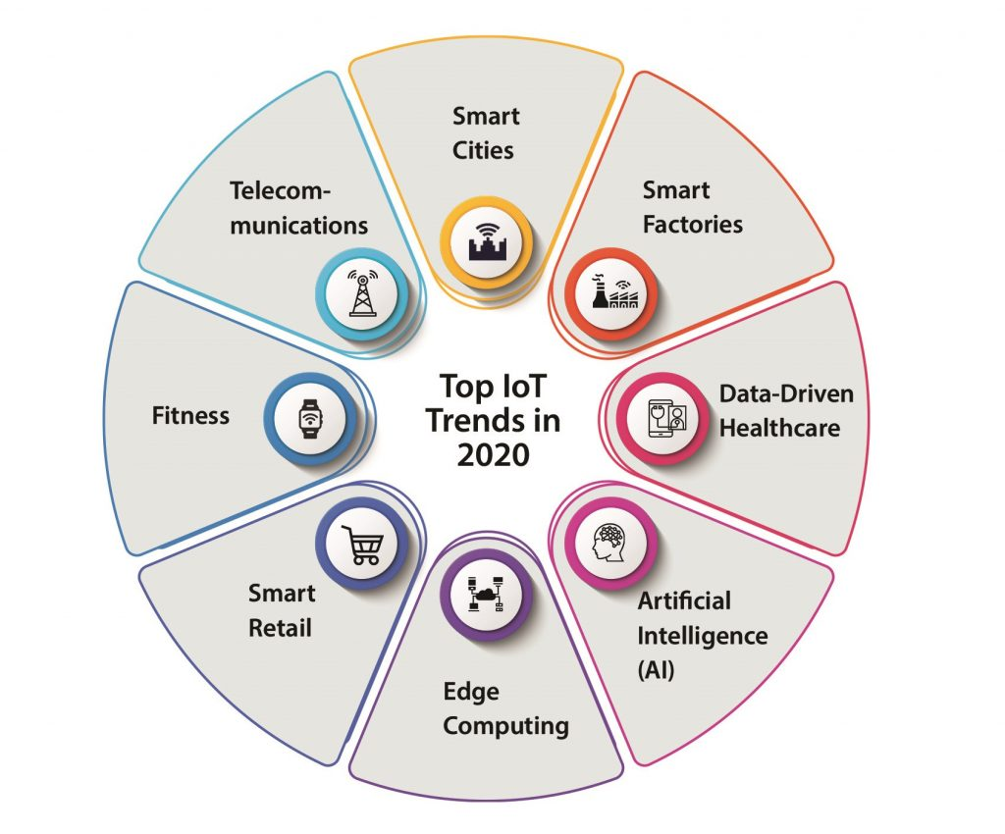
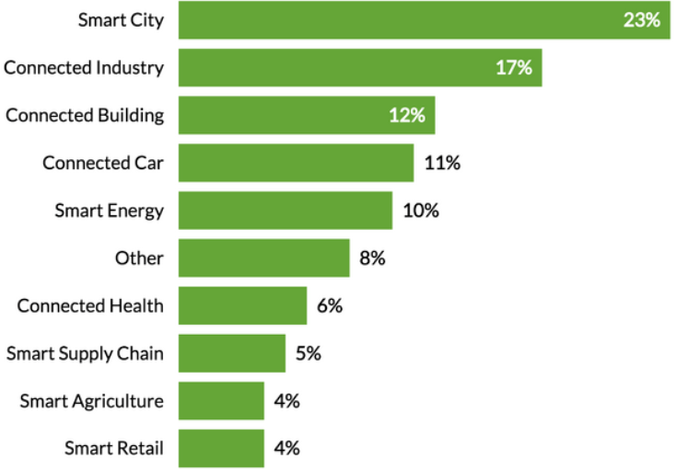
Introduction
Use of IoT is rising across a lot of sectors, including smart homes, smart vehicles, and smart health monitoring devices [1].
Fig. 2: Various Sector of IoT
Fig. 3: Data source: IoT analytics database of project [11]

Slide 9
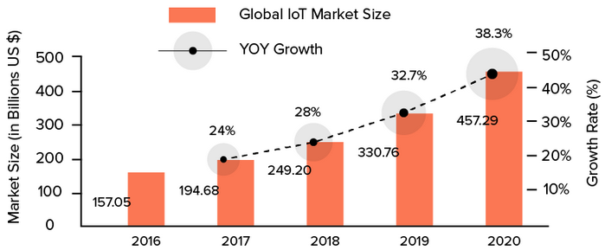
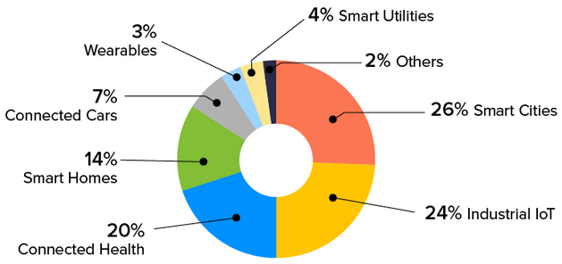
Introduction
The global IoT market was valued at approximately $157.05 billion in 2016.​
The global IoT market is projected to surpass $1.5 trillion by 2023, demonstrating continued strong growth.
Fig. 4: Global IoT Market Size year wise
Fig. 5 : Global IoT Market Share by Sub-Sector

Slide 10
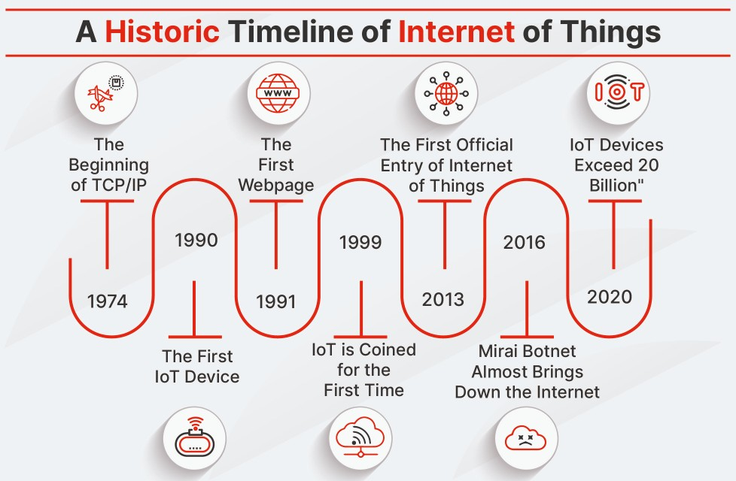
Introduction

Slide 11
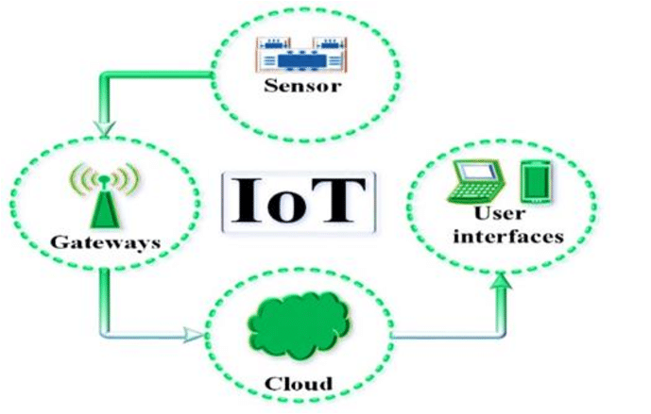
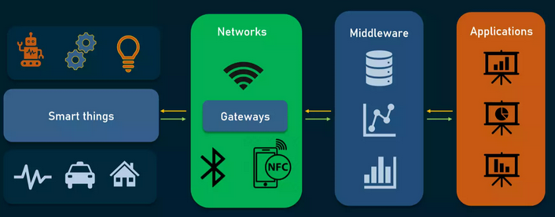
IoT Architecture and Components
Major IoT building blocks and layers
Fig. Components of IoT System

Slide 12
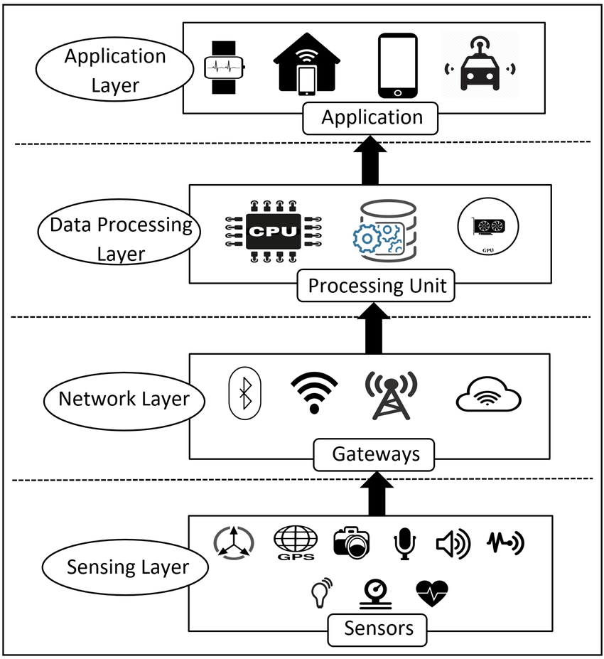
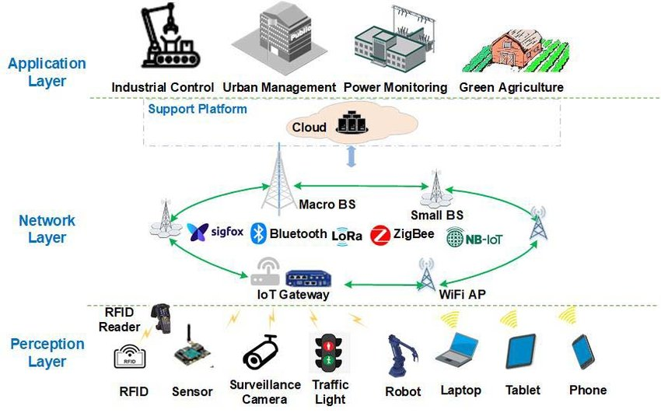
IoT Architecture and Components
Fig: Three Layer IoT Architecture
Fig: Four Layer IoT Architecture

Slide 13
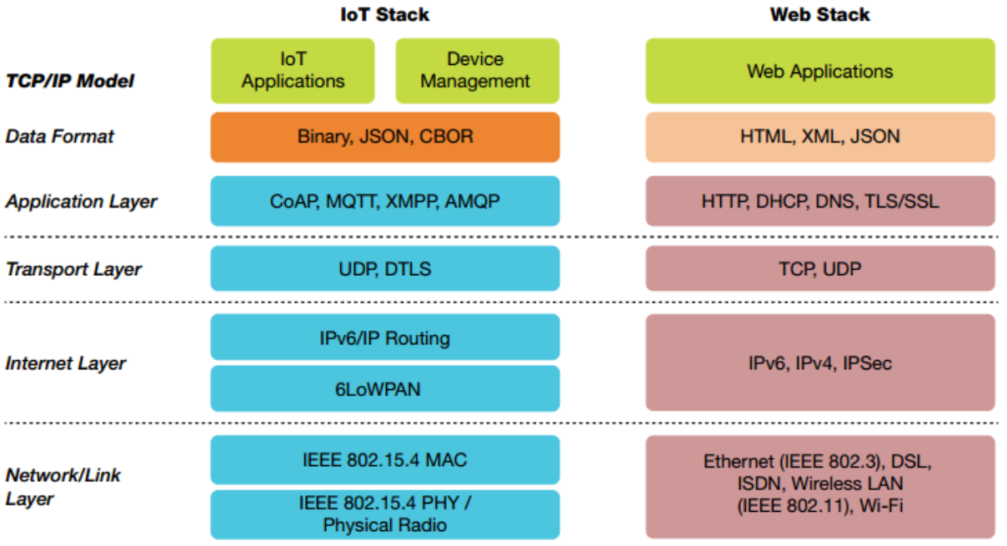
IoT Architecture and Components
IoT Protocol Stack

Slide 14

IoT Architecture and Components
CoAP is a specialized web transfer protocol for use with constrained nodes and constrained networks in the Internet of Things.
CoAP is designed to enable simple, constrained devices to join the IoT even through constrained networks with low bandwidth and low availability.

Slide 15
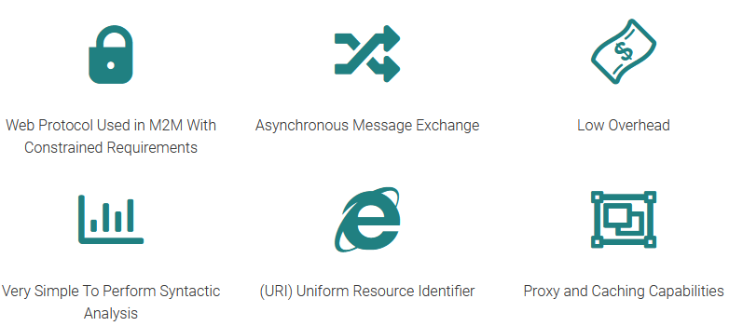
IoT Architecture and Components
CoAP Features

Slide 16
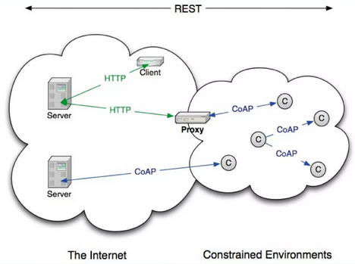
IoT Architecture and Components
Transaction Model
Transport
CoAP is defined for UDP
Messaging
Simple message exchange between end-points
CON,NON,ACK,RST
Rest
Request/response piggybacked on messages
Method, Response code and Options (URI, Contain Type)

Slide 17
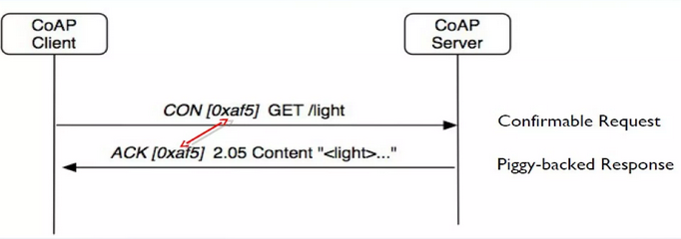
CoAP Client – Server Communication
Request Example

Slide 18
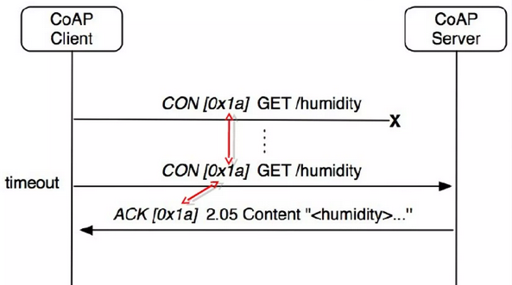
CoAP Client – Server Communication
Dealing with Packet Loss

Slide 19
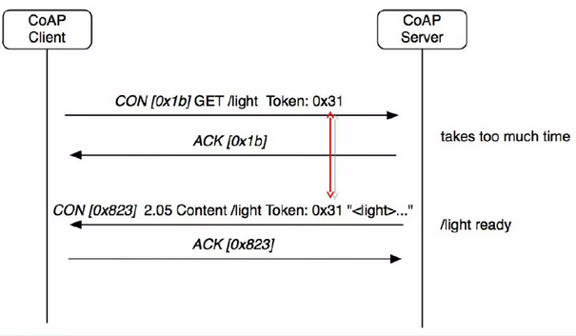
CoAP Client – Server Communication
Separate Response

Slide 20
RPL
RPL (Routing Protocol for Low-Power and Lossy Networks)
RPL is a distance vector routing protocol
The protocol was designed to be highly adaptive to network conditions
and to provide alternate router whenever default routes are inaccessible.
RPL provides a mechanism to disseminate information over the
dynamically formed network topology
Contains thousands of nodes.....

Slide 21

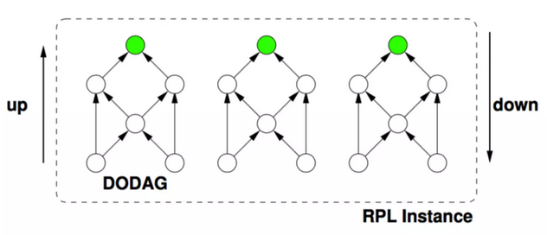
RPL
DODAG (Destination-Oriented Directed Acyclic Graph):
A DODAG is a data structure used in IPv6-based Low-Power and Lossy Networks (LLNs) such as those found in the IoT.
Directed Acyclic Graph: DODAG is a directed acyclic graph, meaning it is a network topology with directional links and no cycles.

Slide 22
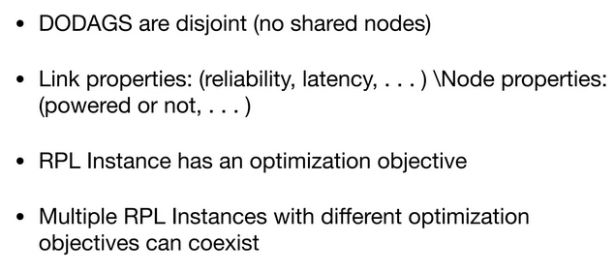
RPL

Slide 23
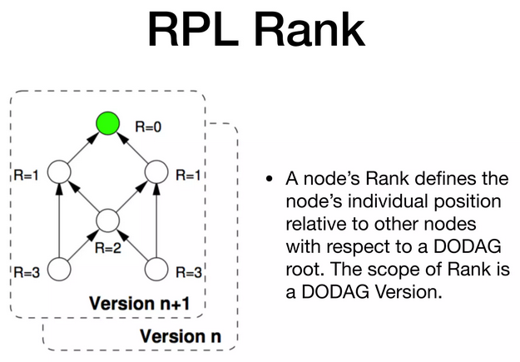
RPL

Slide 24
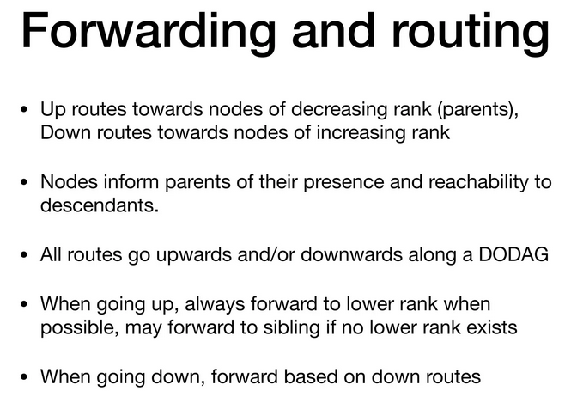
RPL

Slide 25
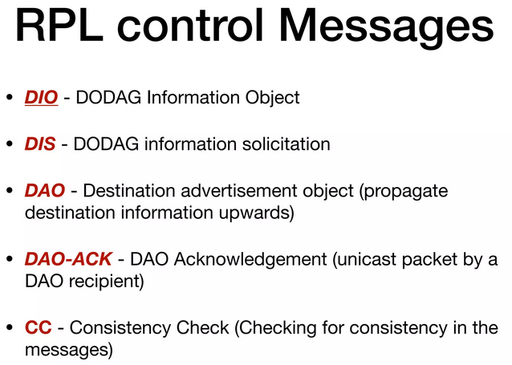
RPL

Slide 26
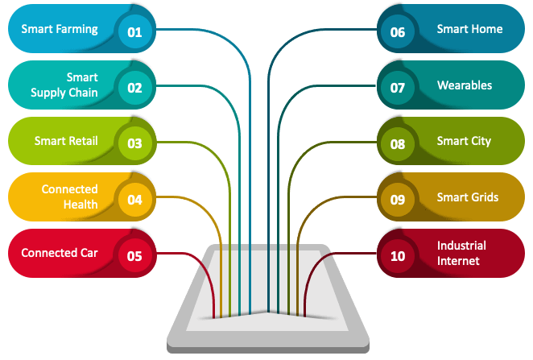
IoT Applications

Slide 27
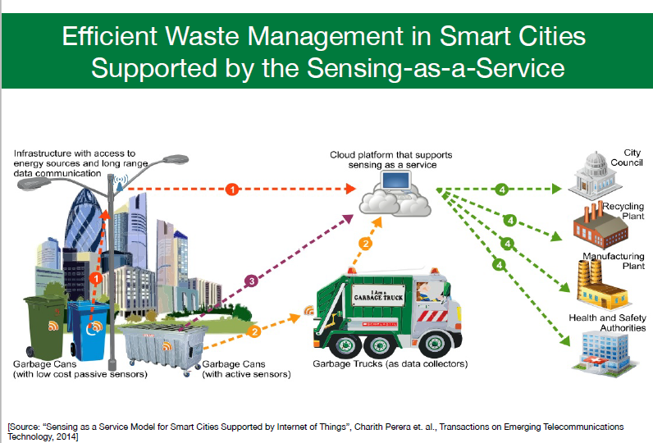
IoT Applications

Slide 28
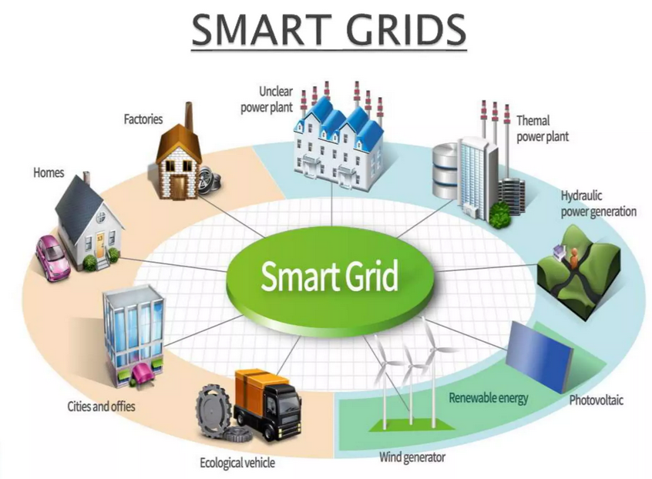
IoT Applications

Slide 29
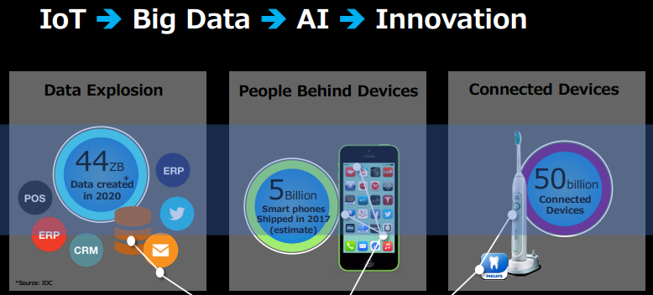
IoT Data Management

Slide 30
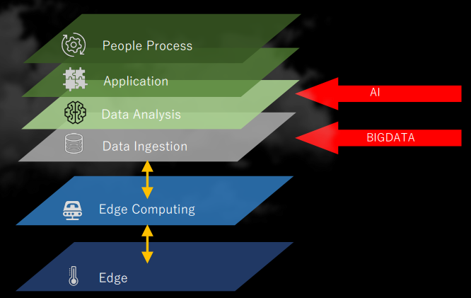
IoT Data Management
Roll of BIGDATA and AI in IoT

Slide 31
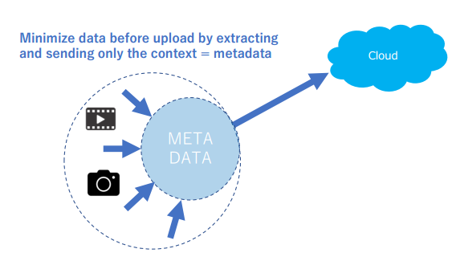
IoT Data Management
Minimizing IoT Data

Slide 32
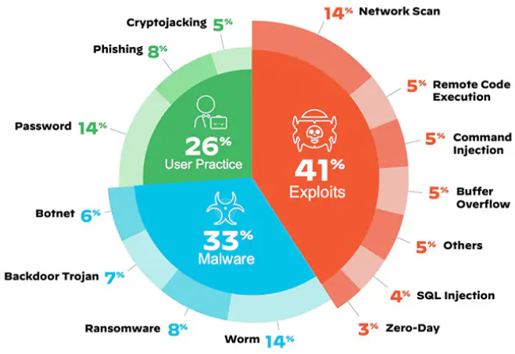
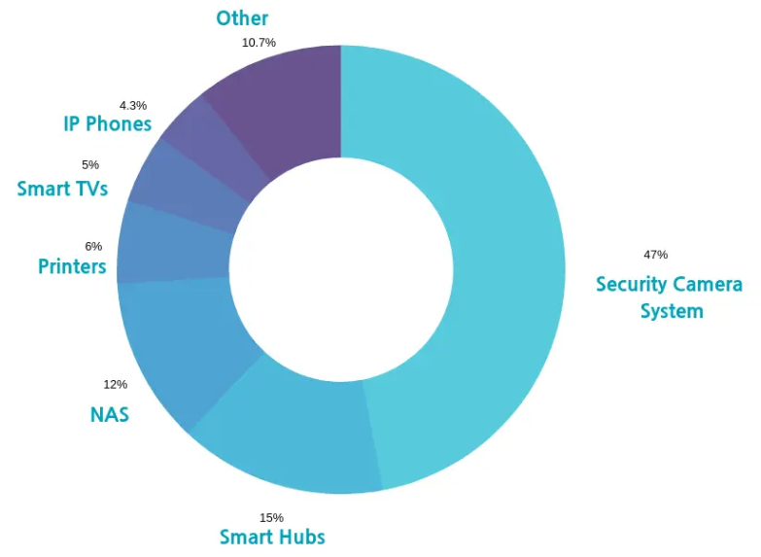
IoT Security
With IoT system benefits, It is vulnerable to many attacks.
Attack objective to violate authenticity, integrity, confidentiality, and availability.
The violation of any of them may incur serious consequences.
Fig. 6: Breakdown of top IoT threats​
Fig. 7: Breakdown of IoT devices in smart home with vulnerability​

Slide 33
Attacks Considered for this Talk
Exploits:
Denial-of-Service (DoS)
Distributed Denial-of-Service (DDoS)
Low-rate DDoS attacks (LRDDoS)
Rank attacks
Sinkhole attacks
Wormhole attacks
Buffer reservation attacks
Malware attack:
Botnets

Slide 34


DDoS and Botnet attacks in IoT
Attack: DDoS, Botnet Attack
DDoS attacks are very harmful to IoT systems as these attacks disrupt the availability of systems.
DDoS attacks, which can be broadly classified into following categories, as given below
High-rate DDoS attack (HrDDoS):
Low-rate DDoS Attacks (LrDDoS):
Mixed-rate DDoS Attacks (MrDDoS):
Fig. 7: DoS Attacks

Slide 35
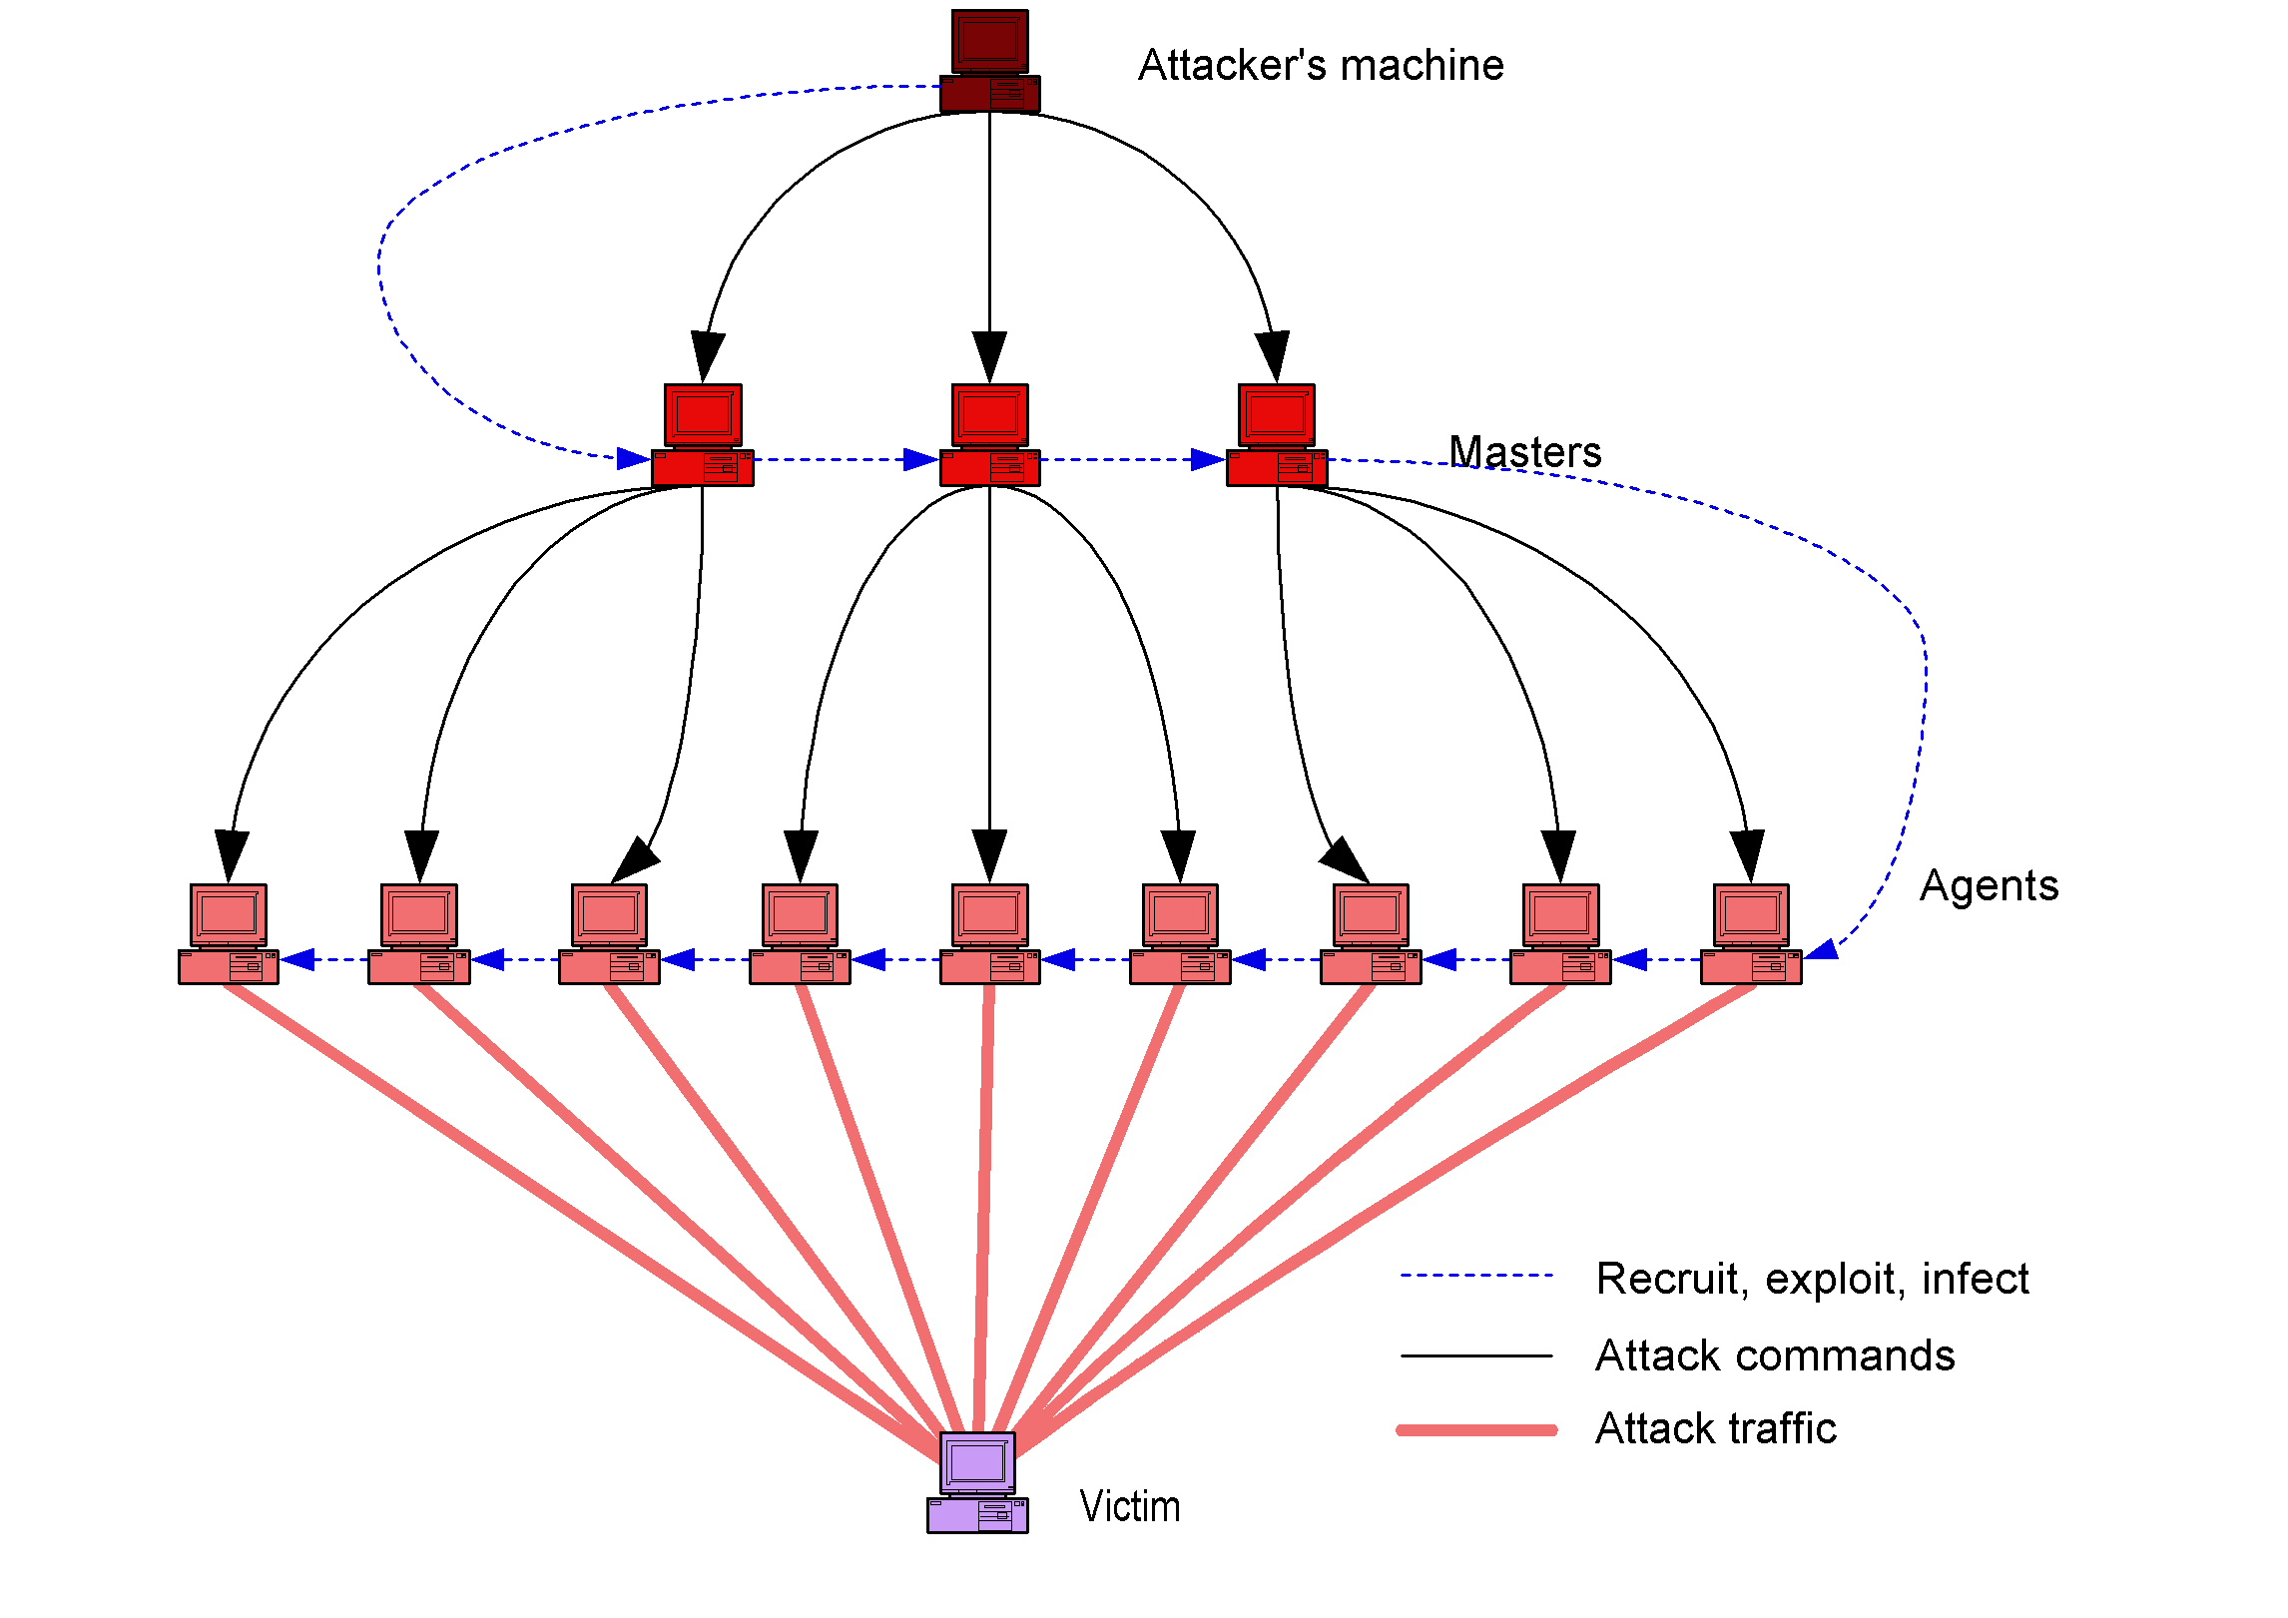
DDoS and Botnet attacks in IoT
Collateral damage points
Fig. 8: DDoS Attack
Fig. 9: Botnet Attack

Slide 36
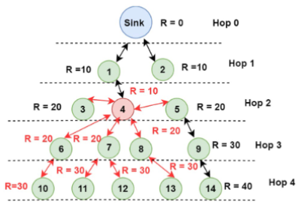
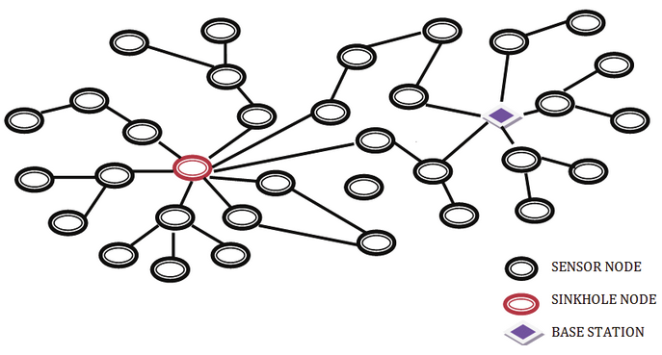
IoT Attack
Rank Attack:
Sinkhole attack

Slide 37
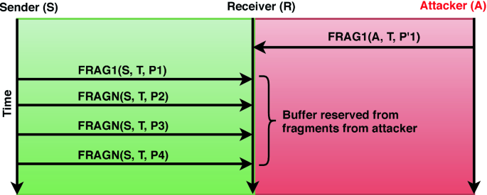
IoT Attack
buffer reservation attacks

Slide 38
Possible IoT Projects

Slide 39

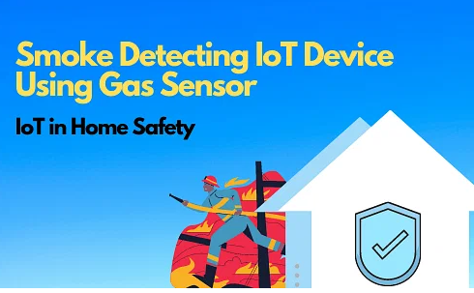
Simple IoT Project
Find Out When Someone Takes Your Stuff – IoT Home Security
Smoke Detecting IoT Device Using Gas Sensor – IoT Home Safety

Slide 40

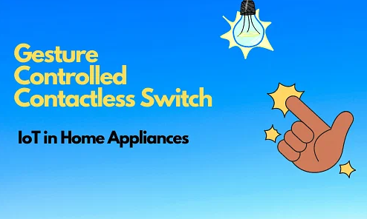
Simple IoT Project
Tank Water Monitoring System
Gesture-Controlled Contactless Switch for Smart Home

Slide 41
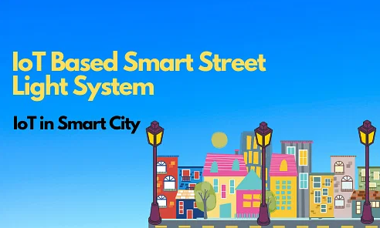
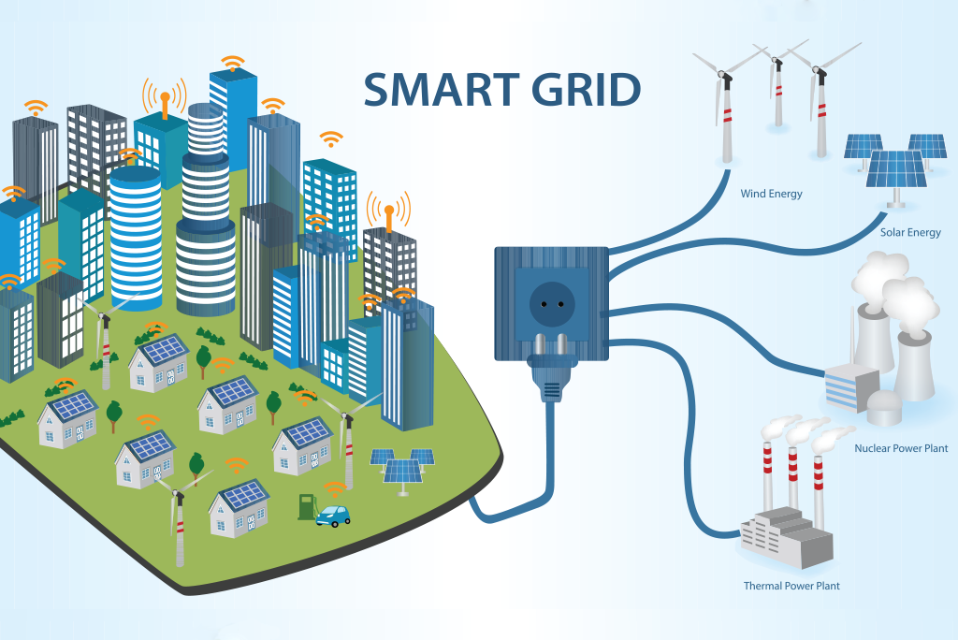
Simple IoT Project
IoT-Based Smart Street Light System
Smart Energy Grid

Slide 42
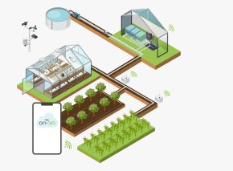
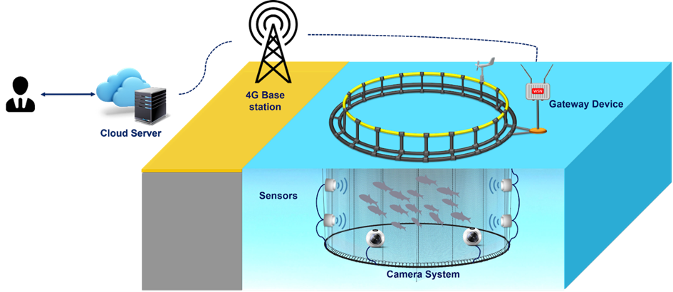
Simple IoT Project
IOT Based Fishery Management System
Smart Agriculture System- IoT in Agriculture

Slide 43
References
[1]. C. Gomez, J. Paradells, C. Bormann, and J. Crowcroft, “From 6LoWPAN to 6Lo: Expanding the universe of IPv6-supported technologies for the IoTs,” IEEE Comm. Magazine, vol. 55, no. 12, pp. 148–155, 2017.
[2]. A. Al-Fuqaha, M. Guizani, M. Mohammadi, M. Aledhari, and M. Ayyash, “IoTs: A survey on enabling technologies, protocols, and applications,” IEEE com. sur. & tut., vol. 7, no. 4, pp. 2347–2376, 2015.
[3]. A. Kuzmanovic and E. W. Knightly, “Low-rate TCP-targeted DoS and counter strategies,” IEEE Trans. on Net., vol. 14, no. 4, pp. 83–96, 2006.
[4] S. T. Zargar, J. Joshi, and D. Tipper, “A survey of defense mechanisms against DDoS flooding attacks,” IEEE com. sur. & tut., vol. 15, no. 4, pp. 2046–2069, 2013.
[5] H. Chen, C. Meng, Z. Shan, Z. Fu, and B. K. Bhargava, “A Novel Low-Rate Denial of Service Attack Detection Approach in ZigBee Wireless Sensor Network by Combining Hilbert-Huang Transformation and Trust Evaluation,” IEEE Access, vol. 7, pp. 32 853–32 866, 2019.
[6] K. Ashton et al., “That ‘internet of things’ thing,” RFID journal, vol. 22, no. 7, pp. 97–114, 2009.
[7] F. John Dian, R. Vahidnia, and A. Rahmati, “Wearables and the Internet of Things (IoT), Applications, Opportunities, and Challenges: A Survey,” IEEE Access, vol. 8, pp. 69 200–69 211, 2020

Slide 44
References
[8] T. Simon, “Chapter seven: Critical infrastructure and the internet of things,” Cyber security in a volatile world, vol. 93, 2017.
[9] J. M. Yusta, G. J. Correa, and R. Lacal-Ar ́antegui, “Methodologies and applications for critical infrastructure protection: State-of-the-art,” Energy Policy, vol. 39, no. 10, pp. 6100–6119, 2011, sustainability of biofuels. [Online]. Available:https://www.sciencedirect.com/science/article/pii/S030142151100533
[10] N.-N. Dao, “Internet of wearable things: Advancements and benefits from 6G technologies,” Future Generation Computer Systems, 2022.
[11] F. Meneghello, M. Calore, D. Zucchetto, M. Polese, and A. Zanella, “IoT: Internet of threats? A survey of practical security vulnerabilities in real IoT devices,” IEEE Internet of Things Journal, vol. 6, no. 5, pp. 8182–8201, 2019.
[12] R. Nath and H. V. Nath, “Critical analysis of the layered and systematic approaches for understanding IoT security threats and challenges,” Computers and Electrical Engineering, vol. 100, p. 107997, 2022.
[13] H. HaddadPajouh, A. Dehghantanha, R. M. Parizi, M. Aledhari, and H. Karimipour,“A survey on internet of things security: Requirements, challenges, and solutions,” Internet of Things, vol. 14, p. 100129, 2021.
[14] A. O. Bang, U. P. Rao, A. Visconti, A. Brighente, and M. Conti, “An iot inventory before deployment: a survey on iot protocols, communication technologies, vulnerabilities, attacks, and future research directions,” Computers & Security, p. 102914, 2022.

Slide 45
References
[15] M. Shukla, S. D. Johnson, and P. Jones, “Does the NIS implementation strategy effectively address cyber security risks in the UK?” in 2019 International Conference on Cyber Security and Protection of Digital Services (Cyber Security), 2019, pp. 1–11. [16] K. Ashton et al., “That ‘internet of things’ thing,” RFID journal, vol. 22, no. 7, pp. 97–114, 2009. [17] A. Al-Fuqaha, M. Guizani, M. Mohammadi, M. Aledhari, and M. Ayyash, “Internet of Things: A Survey on Enabling Technologies, Protocols, and Applications,” IEEE Communications Surveys Tutorials, vol. 17, no. 4, pp. 2347–2376, 2015. [18] F. John Dian, R. Vahidnia, and A. Rahmati, “Wearables and the Internet of Things (IoT), Applications, Opportunities, and Challenges: A Survey,” IEEE Access, vol. 8, pp. 69 200–69 211, 2020. [19] T. Simon, “Chapter seven: Critical infrastructure and the internet of things,” Cyber security in a volatile world, vol. 93, 2017. [20] J. M. Yusta, G. J. Correa, and R. Lacal-Ar ́antegui, “Methodologies and applications for critical infrastructure protection: State-of-the-art,” Energy Policy, vol. 39, no. 10, pp. 6100–6119, 2011, sustainability of biofuels. [Online]. Available: https://www.sciencedirect.com/science/article/pii/S0301421511005337 [21] E. Twahirwa, K. Mtonga, K. Jayavel, P. Bamurigire, and W. Kasakula, “Technology Empowered Healthcare Response in Pandemics: An IoT-based Covid-19 Test and Isolate System,” in 2022 E-Health and Bioengineering Conference (EHB), 2022, pp. 1–4

Slide 46
References
[22] C.-X. Wang, X. You, X. Gao, X. Zhu, Z. Li, C. Zhang, H. Wang, Y. Huang, Y. Chen, H. Haas, J. S. Thompson, E. G. Larsson, M. D. Renzo, W. Tong, P. Zhu, X. Shen, H. V. Poor, and L. Hanzo, “On the Road to 6G: Visions, Requirements, Key Technologies, and Testbeds,” IEEE Communications Surveys Tutorials, vol. 25, no. 2, pp. 905–974, 2023. [23] N.-N. Dao, “Internet of wearable things: Advancements and benefits from 6G technologies,” Future Generation Computer Systems, 2022. [24] Z. Qadir, K. N. Le, N. Saeed, and H. S. Munawar, “Towards 6G Internet of Things: Recent advances, use cases, and open challenges,” ICT Express, vol. 9, no. 3, pp. 296–312, 2023. [25] F. Meneghello, M. Calore, D. Zucchetto, M. Polese, and A. Zanella, “IoT: Internet of threats? A survey of practical security vulnerabilities in real IoT devices,” IEEE Internet of Things Journal, vol. 6, no. 5, pp. 8182–8201, 2019. [26] W. Liao, S. Salinas, M. Li, P. Li, and K. A. Loparo, “Cascading Failure Attacks in the Power System: A Stochastic Game Perspective,” IEEE Internet of Things Journal, vol. 4, no. 6, pp. 2247–2259, 2017. [27] M. A. Husnoo, A. Anwar, N. Hosseinzadeh, S. N. Islam, A. N. Mahmood, and R. Doss, “False data injection threats in active distribution systems: A comprehensive survey,” Future Generation Computer Systems, 2022. [28] S. Khanam, I. B. Ahmedy, M. Y. Idna Idris, M. H. Jaward, and A. Q. Bin Md Sabri, “A Survey of Security Challenges, Attacks Taxonomy and Advanced Countermeasures in the Internet of Things,” IEEE Access, vol. 8, pp. 219 709–219 743, 2020.

Slide 47
Thank You

Slide 48


